Slide 1
BELGIAN CONSUMER SENTIMENT
purchase behavior & buying attitudes during Covid-19

Slide 2


















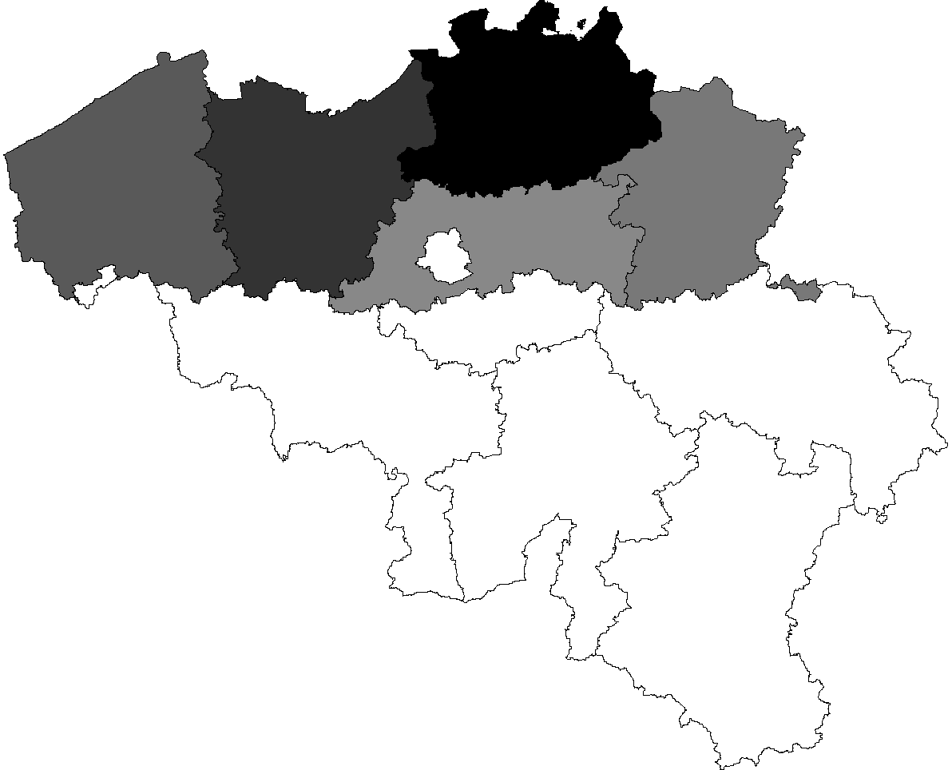
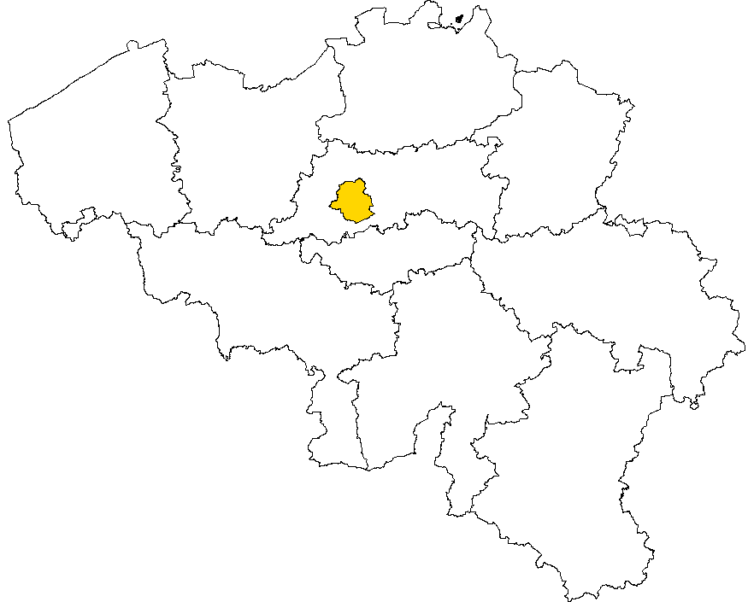
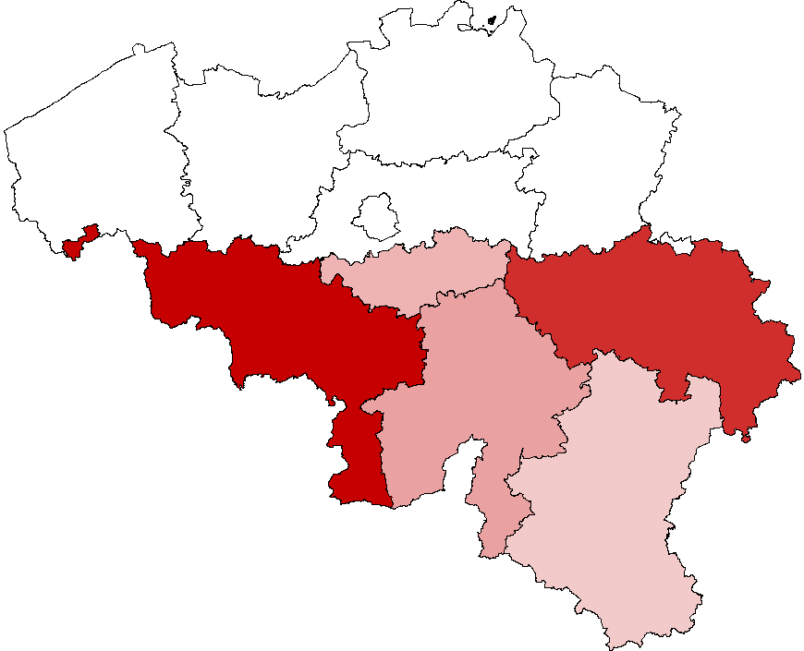






METHODOLOGY & SAMPLING
questionnaire
methodology
sample
CASI
n=500
panel provider
field
avg duration
Fri April 10th –
Wed April 15th
13m13s
Gender
Language
Prof. active
Age
51%
49%
58%
42%
52%
12%
18-24 y.o.
18%
25-34 y.o.
26%
35-49 y.o.
25%
50-64 y.o.
19%
65+
Region
Professional situation
59%
10%
31%
1%
self-employed.
8%
liberal prof. & management
32%
employee
11%
worker
8%
student
22%
retired

Slide 3
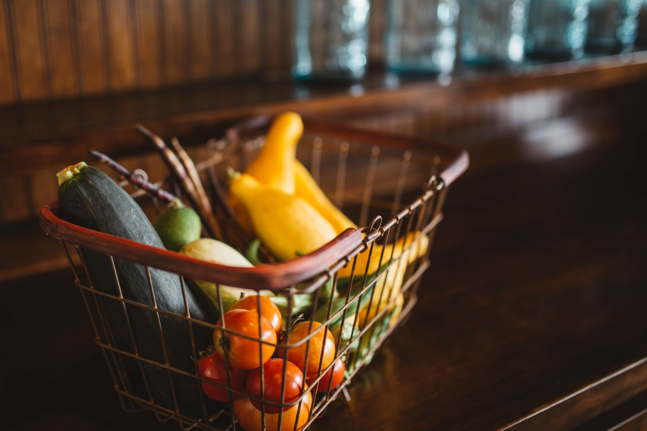
NEW BUYING HABITS AND MAIN ACTIVITIES

Slide 4

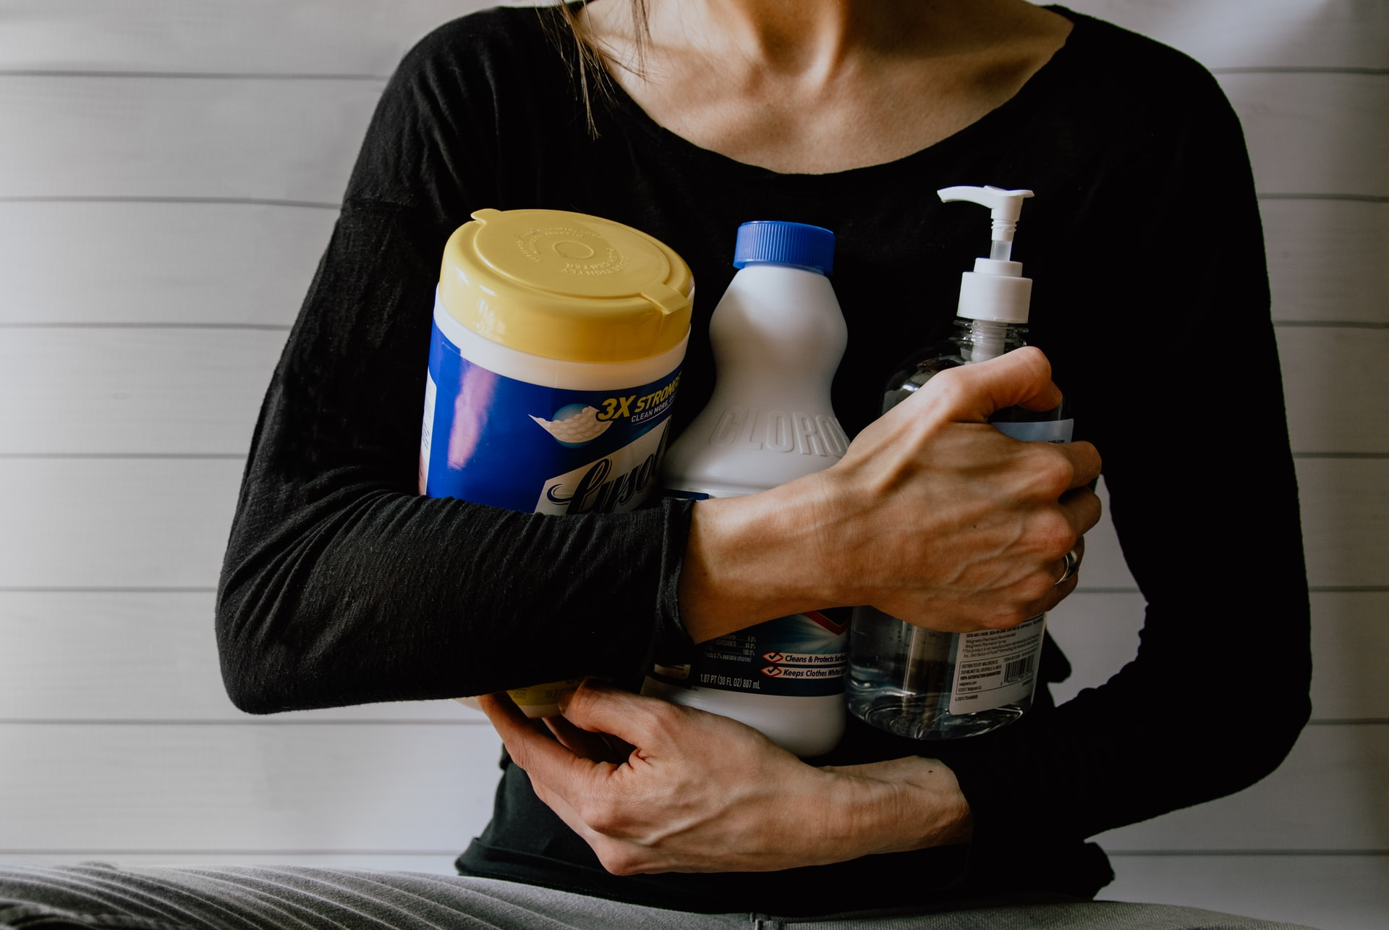

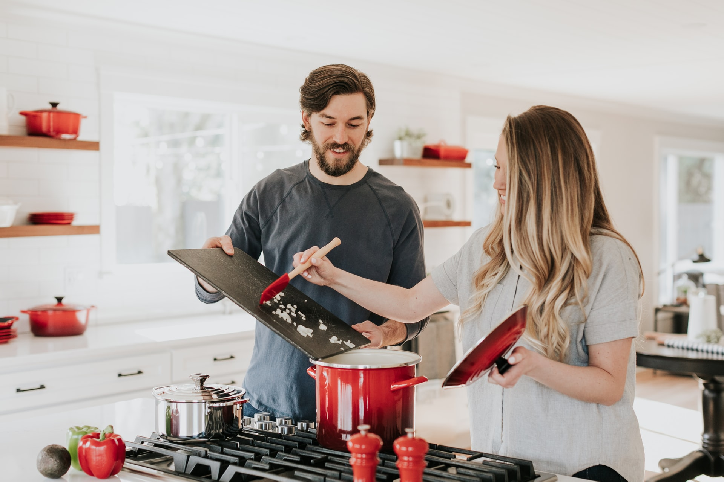

BASIC NEEDS DURING CONFINEMENT? MEDIA! (WITH A FULL BELLY IN A TIDY HOUSE)
1
2
3
67%
55%
55%
surfing on the internet
cleaning/tidying the house
watching TV w/family
4
5
52%
cooking
44%
watching videos & movies
What have been your main activities during the past few days? Source pictures: Unsplash

Slide 5
SURFING IS THE N°1 ACTIVITY ACROSS ALL GENERATIONS
DIGITAL ACTIVITIES DOMINATE THE MEDIA DIET OF GEN Z…
AND THE INTERNET THE DAILY LIFE OF BOOMERS
Audiovisual, meaning not only TV, and digital media dominate the TOP 5 (main) activities of young adults and Gen X’ers during the lockdown. Age groups with a higher density of kids between 6 and 15 y.o. tend to watch TV with family members more than younger age groups without or with younger kids
50+ers have been taken care of their home: Spring cleaning, gardening, doing odd jobs have been part of their new everyday life. Only 21% of 50+ mentioned working as main activity (vs 33% of 50-64 y.o.). But don’t neglect the importance of internet: 7 out of 10 50+ers mention surfing on the internet as main activity
1
2
18-34 y.o.
35-49 y.o.
50-64 y.o.
65+
What have been your main activities during the past few days?

Slide 6










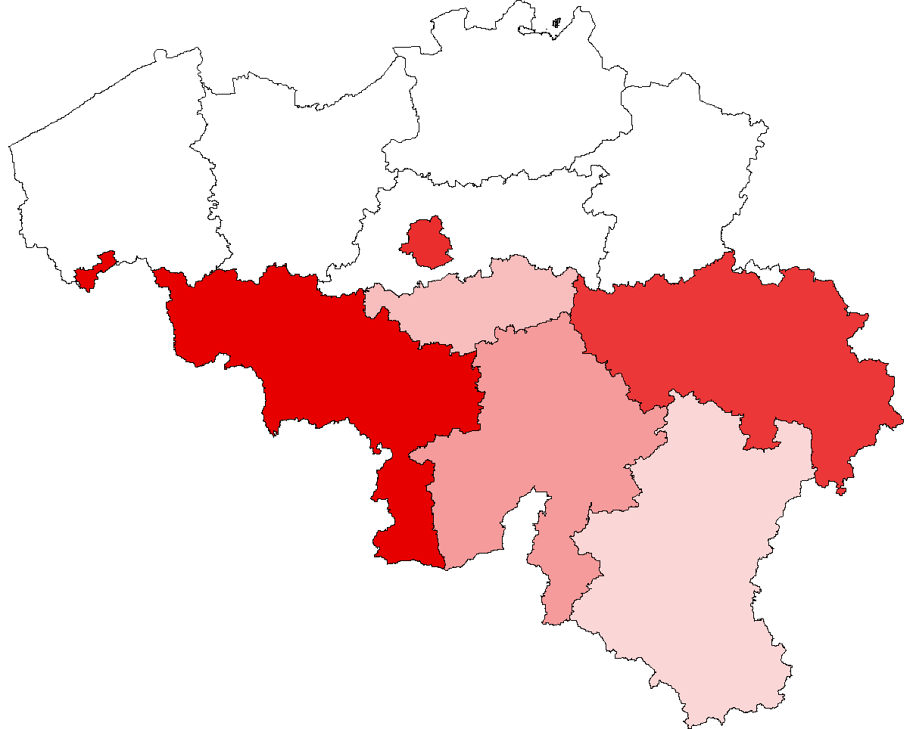
TV, NEWSBRANDS AND RADIO ARE THE TOP 3 MEDIA OF INFORMATION
But every audience has its own information diet. Homeworkers are more into magazines (5%), brands & retail sites (6%) and newsbrands (16%). Partially unemployed listen more to radio (16%) and watch more TV (22%).
TOP 5 (ranked on affinity)
HOMEWORKING
5%
aff. 121
3%
aff. 119
6%
aff. 119
16%
aff. 111
2%
aff. 99
PARTIALLY UNEMPLOYMED
3%
aff. 145
16%
aff. 130
13%
aff. 121
3%
aff. 119
22%
aff. 114
brand & retail web
WOM
12%
aff. 113
5%
aff. 102
5%
aff. 101
15%
aff. 100
19%
aff. 98
leaflet
3%
aff. 139
3%
aff. 122
13%
aff. 108
4%
aff. 103
20%
aff. 102
On a scale from 1 to 10, Which media did you use the most to keep you informed during the lockdown? (1-not used a lot; 10-used the most; scores 7-10 grouped)

Slide 7
EVERY GENERATION HAS ITS PREFERRED MEDIA
Young adults tend to use social networks, word-of-mouth and brand & retail websites more than other age groups. Gen Yers mention leaflet and OOH more often. More usual suspects such as TV and radio have more influence on Gen Xers and younger Baby boomers. The senior age group relies more often on magazines.
TOP 5 most used media (ranked on affinity index)
18-24 y.o.
25-34 y.o.
35-49 y.o.
50-64 y.o.
+65 y.o.
On a scale from 1 to 10, Which media did you use the most to keep you informed during the lockdown? (1-not used a lot; 10-used the most; scores 7-10 grouped)

Slide 8

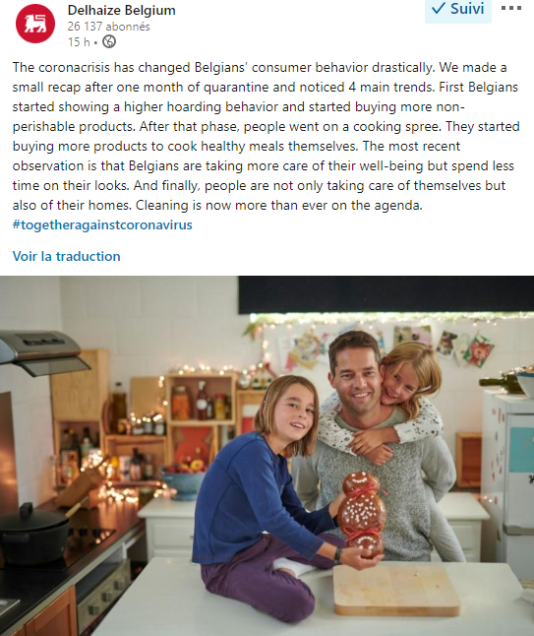


SPRING IS IN THE AIR!
(21/04/2020)
SPRING CLEANING ON THE AGENDA
55%
of respondents mentioned cleaning as their main activity last week
1
WOMEN’S DEVOTIONAL SPRING CLEANING
64%
of women have cleaned the house last week. Did men help with the household chores? 45% mention this activity as a major activity
2
AND THE WINNER IS… DETTOL
+302%
DETTOL saw its sales tripled in last 5 weeks (15/04/2020 in Retail Detail)
3
What have been your main activities during the past few days?

Slide 9
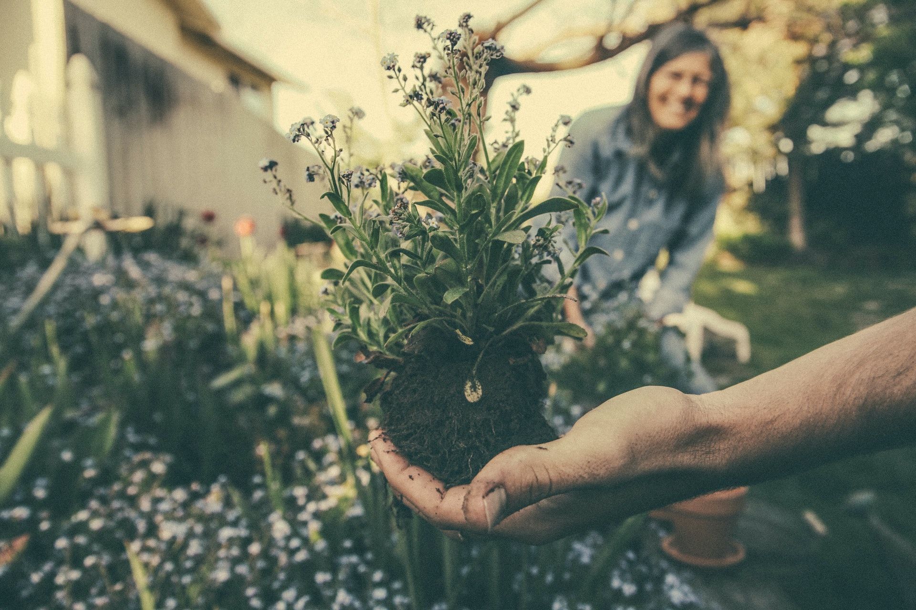
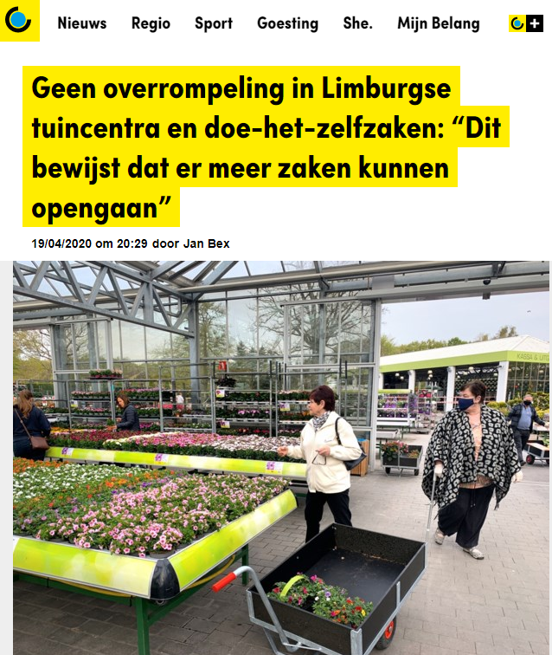



TIME TO MAKE THE GARDEN SUMMER PROOF
GARDENING AS A MAJOR ACTIVITY
41%
of respondents mentioned gardening as their main activity last week. (1 out of 2 within Baby boomers)
1
e-GARDENING ON THE RISE
10%
of respondents have visited NEW gardening & DIY e-commerce sites. Specialized stores must ensure their presence online
2
CONTENT IS EXPECTED
21%
expect content from media about gardening & home improvement, esp. Walloon people
3
Since Saturday April 18th, improvement shops and garden centers were allowed to reopen by the Natonal Security Council to the delight of all the gardening aficionados: as a matter of fact, 19% of Belgians had delayed the purchase of gardening products due to the lockdown
1.What have been your main activities during the past few days? 2.Have you visited new e-commerce sites for DIY or gardening products?

Slide 10
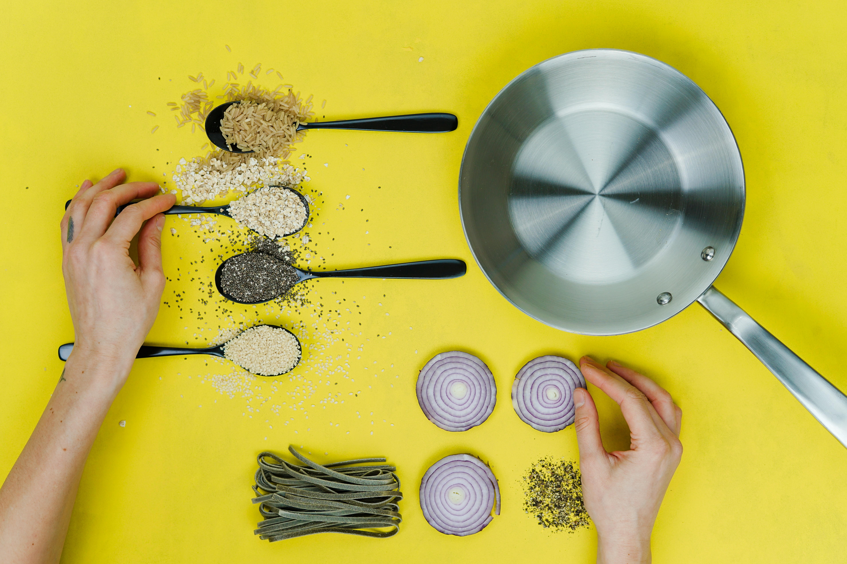

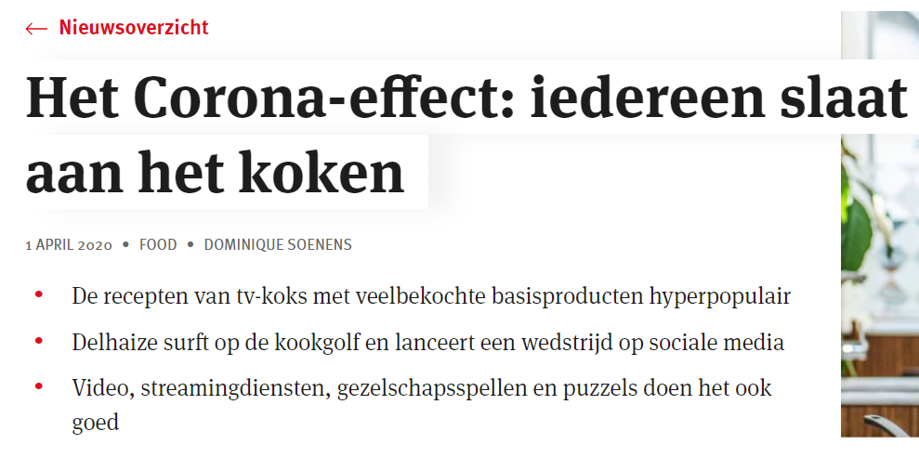
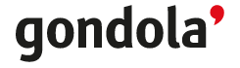
BUT NOTHING BEATS A HOME-COOKED MEAL
COOKING AS A MAJOR ACTIVITY
52%
of Belgians mentioned cooking. More women than men (62% vs 41%)
1
BELGIANS DISCOVER e-GROCERY SHOPPING…
19%
of Belgians have visited NEW e-commerce food & retail sites. 10% visited the site of a physical retailer they used to visit before the pandemic
2
AND ORGANIC FOOD ONLINE SERVICES
9%
of Belgians have visited NEW online organic (food) sites. The interest for this type of suppliers is higher amongst 18-34 y.o. (19%)
3
1.What have been your main activities during the past few days? 2/3.Have you visited new e-commerce sites for

Slide 11
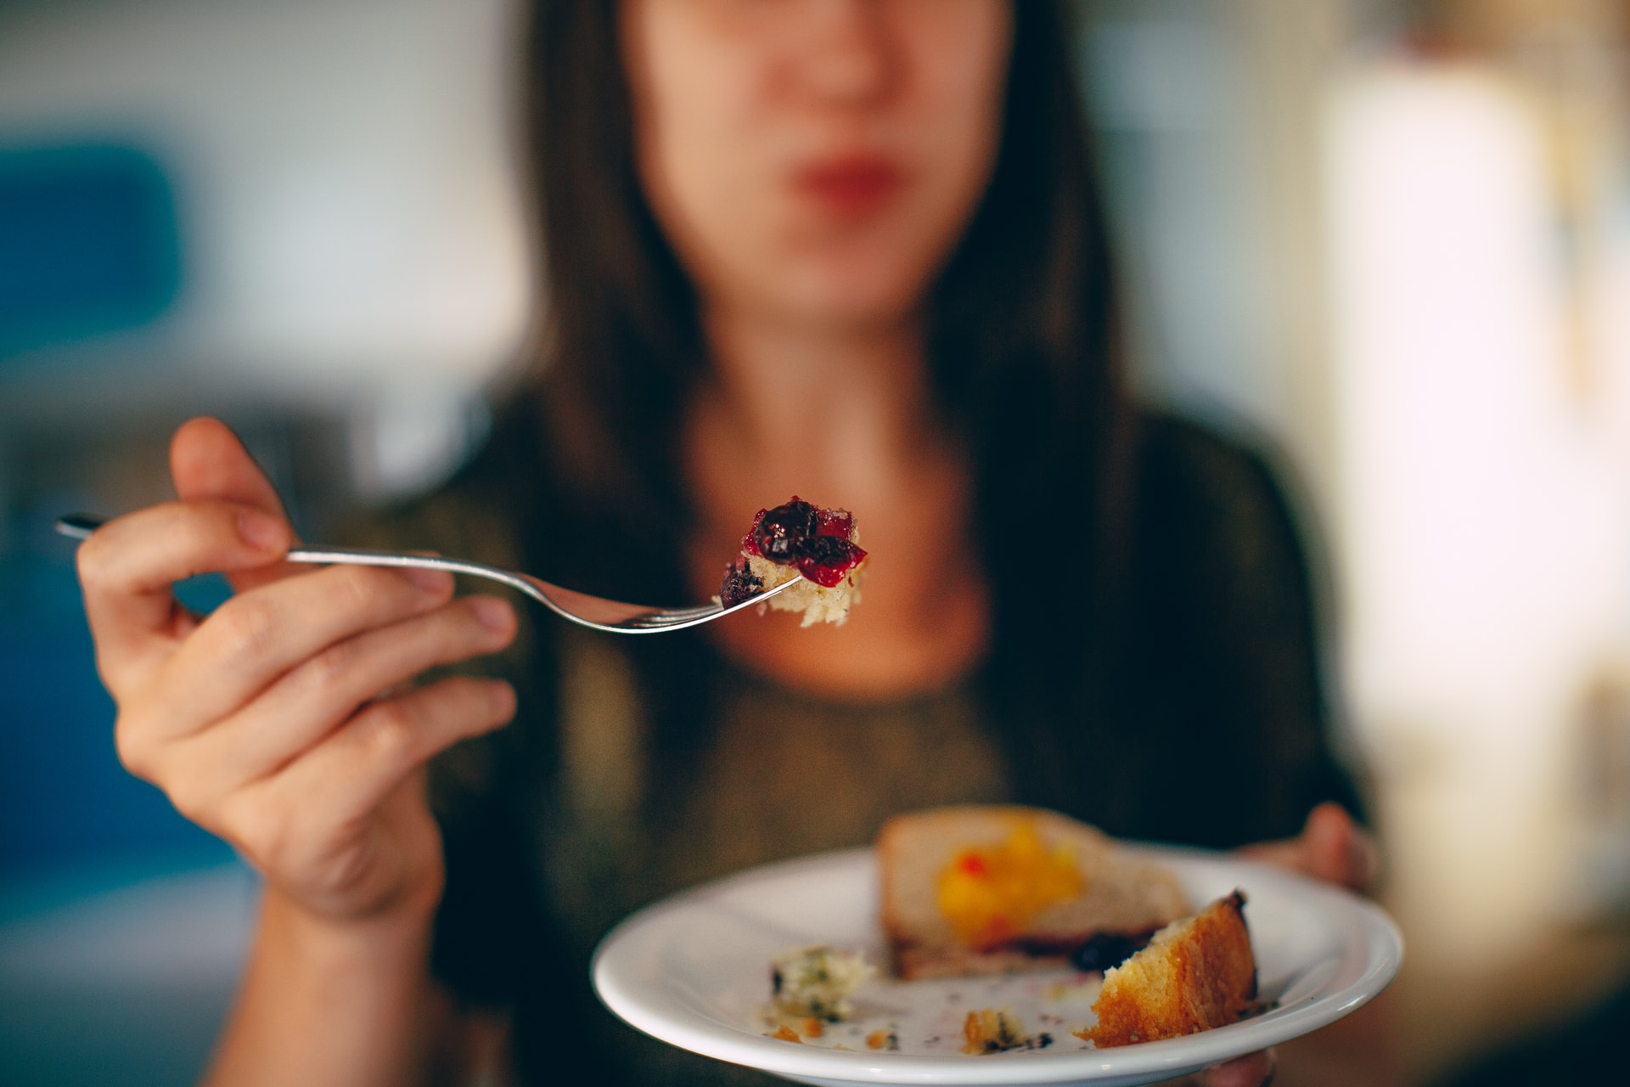







CONFINEMENT SHAPES NEW EATING HABITS
GEN Z EATS HEALTHIER THAN BEFORE
63%
of respondents have not changed their eating habits. 19% are eating less healthy foods than usual, 18% more healthy. Within the younger age group18-24 y.o., 40% claim to have switched to a more healthy diet
1
(more than) ONE OUT OF FIVE DISCOVER NEW EATING TRENDS
23%
think the situation is perfect to learn cooking mono-product dishes (based on pasta, rice…). Belgians are more interested in food products & services on social media as before the lockdown, the analysis of SOPRISM demonstrate:
2
SOFT DRINKS
YOGURT
WAFFEL
PASTA
+79%
+79%
+28%
+4%
PLEASURE IN FOOD IS A BASIC NEED
63%
of respondents claim they continue to purchase food products that make them happy. In the same way as before the lockdown. Especially older people of 65+ (72%) refuse to be denied the right to purchase food for “pleasure”
3
1. Do you feel like: you are eating more/less healthy or as usual? 2. Does this condition of confinement creates favourable conditions to purchase something specific or behave differently?3.What are the purchases that you continue to make almost normally?

Slide 12
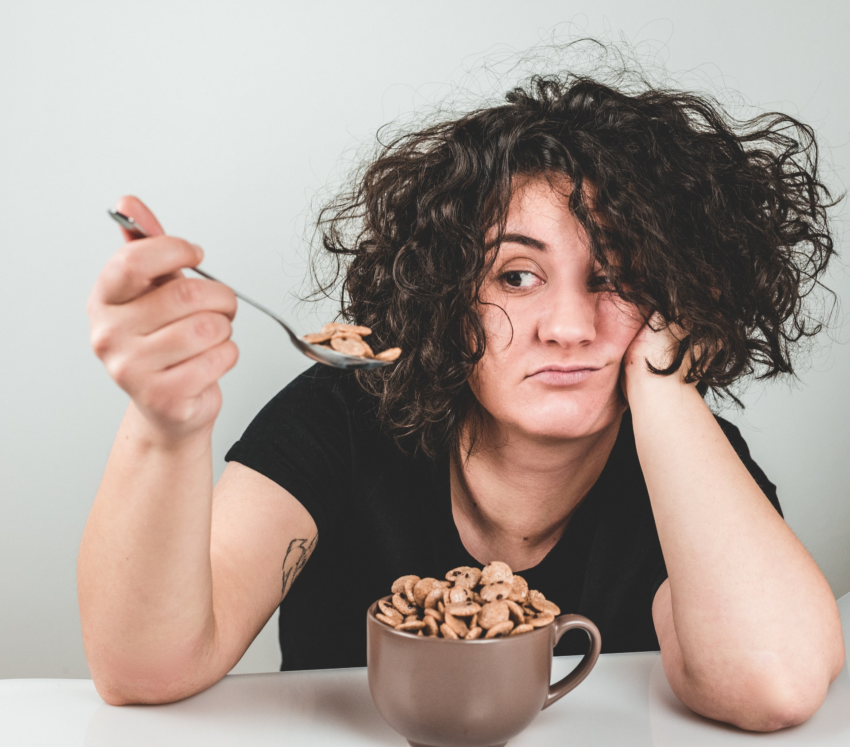
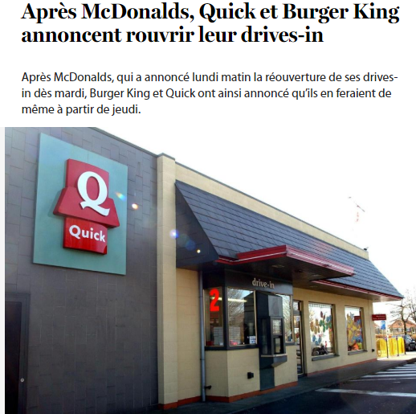


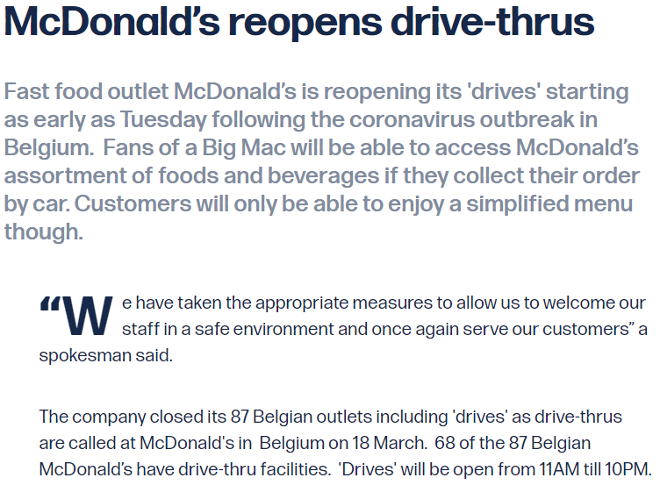
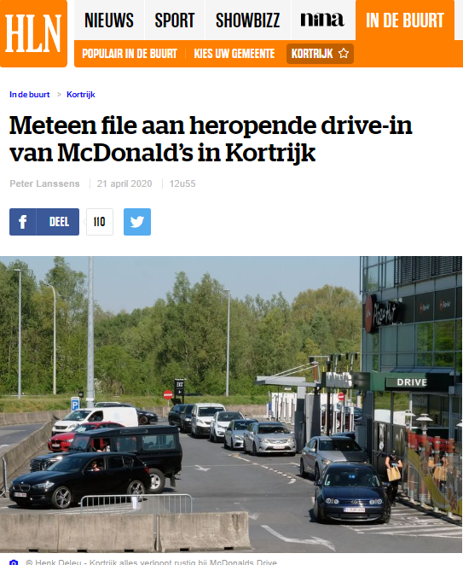
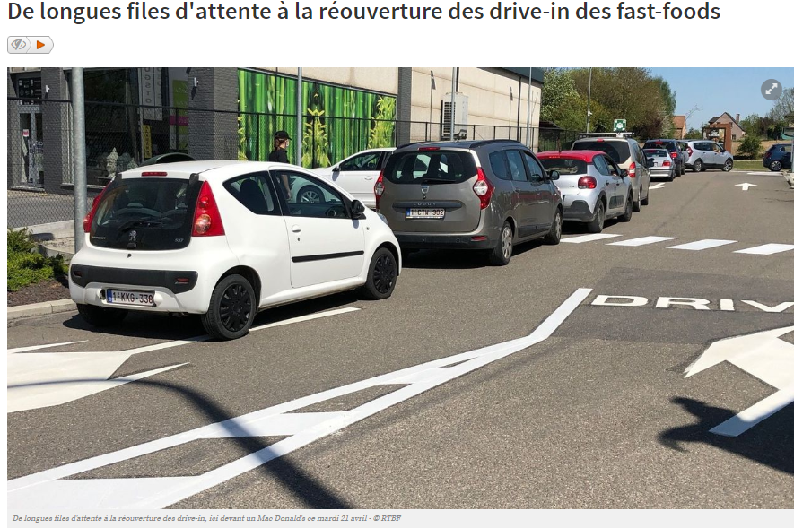


LOCKDOWN SHAPES ALSO NEW BUYING HABITS
ONLINE SHOPPING & DELIVERY SERVICES BOOMED
21%
of respondents used online shopping & delivery services a lot during lockdown. Younger ones are the most heavy users with 37% of 18-34 y.o. having used these services more often the past few weeks
1
DRIVE SERVICES APPEAL (MORE) TO 18-34 y.o.
12%
of respondents used more drive service for grocery shopping, 21% within 18-34 y.o. Younger ones are the most heavy users with 14% of 18-34 y.o. having used these services often.
20/04/2020
2
And good news: Quick, McDonald’s and Burger King announced and reopened their drive-thrus!
With massive road congestions as a result…
1. On a scale from 1 to 10, to which extend have you used the following services during confinement? (1:not used often/a lot -10: used often/lot; scores 7-10 grouped). 2. See 1 + How does this situation changed your buying behavior? You do/use more… (Yes)

Slide 13





IN THE FUTURE BOOMERS & SENIORS WILL BUY MORE LOCAL
What do you think will change in your future consumption after the lockdown?
TOP 5 (ranked on affinity)
buy more local
20%
aff. 123
32%
aff. 110
38%
aff. 103
27%
aff. 96
28%
aff. 94
more savings
32%
aff. 106
29%
aff. 104
36%
aff. 97
26%
aff. 90
13%
aff. 77
limit waste
18-34 y.o.
37%
aff. 124
30%
aff. 110
31%
aff. 106
17%
aff. 105
34%
aff. 94
store essential items
35-49 y.o.
38%
aff. 127
28%
aff. 95
25%
aff. 89
29%
aff. 78
11%
aff. 66
conscious buying
43%
aff. 117
19%
aff. 116
29%
aff. 99
20%
aff. 67
+ 50 y.o.
28%
aff. 100
What do you think will change in your future consumption after the lockdown?

Slide 14


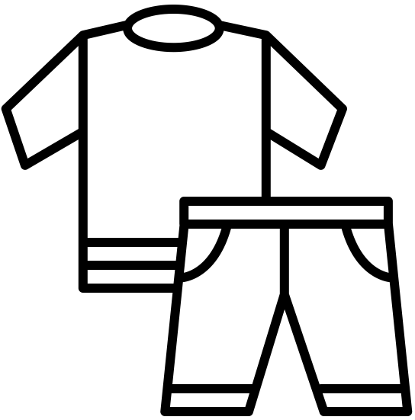

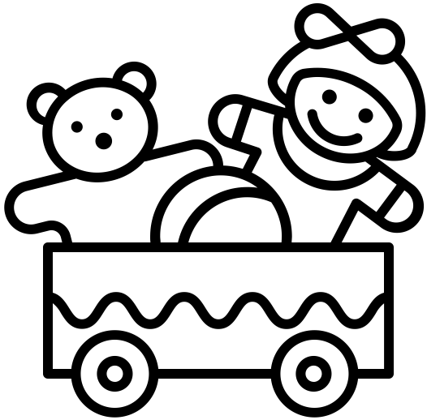







HOW GEN Y & GEN Z CHANGED THEIR BUYING HABITS
18-34 y.o. ARE BOOKWORMS
Your consumption is….
Nearly 1 out of 4 adults between 18 and 34 y.o. bought more books and cultural products. Bol.com (37%) & Amazon (21%) scored as the most useful (non-food) retailers within this age group
FASHION VICTIMS OR MASK MAKERS?
1 out of 10 women bought more clothing & textiles (vs 7% of men). More surprisingly: nearly 1 out of 5 adult between 18 and 34 y.o. did the same. 39% have discovered new e-commerce sites
How does this COVID19 situation change your buying behavior? You do …
(nearly) 1 OUT OF 5 YOUNG PARENTS SPOILED THEIR KIDS
19% of respondents aged between 25-34 bought more toys than before the lockdown. 1 out of 4 parents aged between 25-34 has visited new e-commerce sites selling toys (26%). 27% of 18-50 y.o. have mentioned “playing with family” as a main activity
14%
buy more books &
cultural products
9%
buy more textile &
clothing
8%
buy more toys
9%
buy more sports equipment
18-34 y.o. BUY MORE SPORT PRODUCTS
1 out of 5 young adults bought more sports equipment (19%). French-speaking people (10%) also bought more sport products. Food for thought: Decathlon ranked second to Amazon as the most useful non-food retailer among French-speaking

Slide 15



LOCKDOWN: 1 OUT OF 2 SPENT THE SAME OR MORE
Actually, do you have the impression to spend… ?
SPEND LESS
SAME
SPEND MORE
51% aff 118
34% aff 117
33% aff 121
homeworking
JOB
partially unemployed
Dutch-speaking
45% aff 103
33% aff 112
30% aff 110
+ 50 y.o.
men
women
4 OUT OF 10 SPEND LESS THAN USUAL
More than 1 out of 2 spent more or the same amount of money than before the lockdown. Flemish people were the most likely to spend more, followed by women and Gen Xers (32%)
At the opposite, 1 out of 2 homeworkers spent less. Boomers and homeworkers were more cautious
Partially unemployed people, men, French-speaking people (30%) did not changed their spending habits

Slide 16
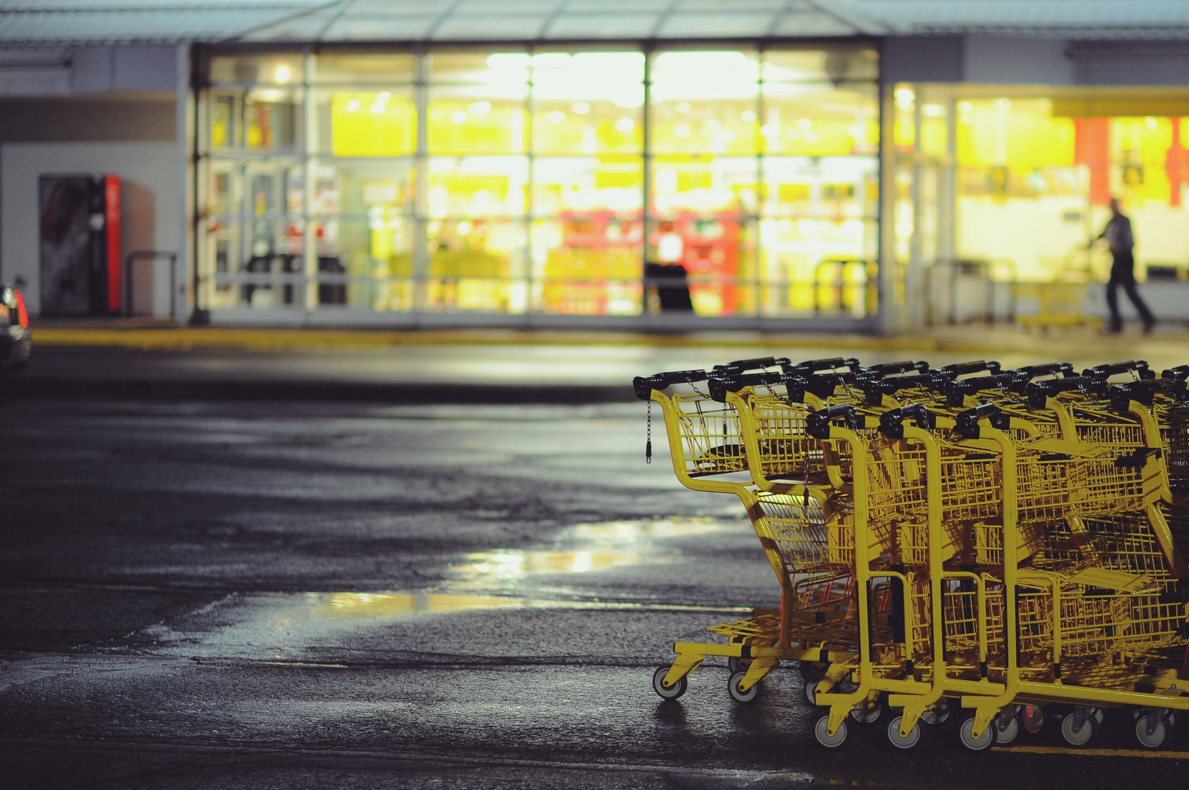
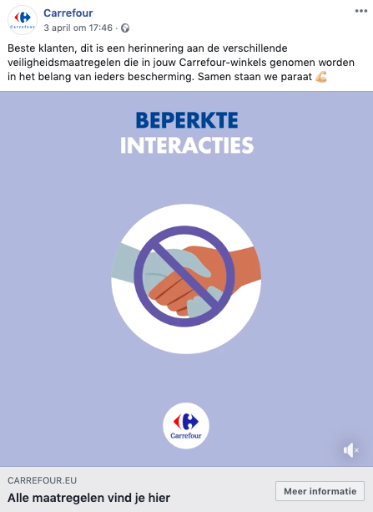
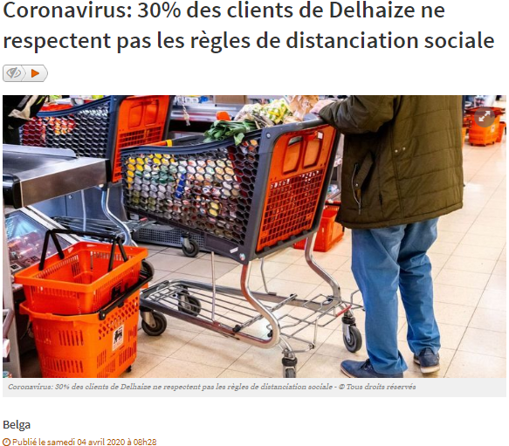
BELGIANS MISS PHYSICAL STORES… BUT NOT THEIR VISITORS
WOMEN MISS RETAIL STORES
50%
of respondents miss visiting retail stores.
Women more often state they miss (window) shopping (58%)
1
SUPERMARKETS ARE DOING A GREAT JOB
63%
feel safe and in security while doing the grocery shopping. French-speaking people have more varied opinions: only 58% feel safe (vs 66% of Flemish-speaking people)
2
“L’ENFER, C’EST LES AUTRES” (HELL IS OTHER PEOPLE)
78%
Contamination by other shoppers is the biggest fear while shopping. Women and 25-34 y.o. are the most worried (81%). Young adults (18-24 y.o.) the less (68%)
3
1.Do you miss going to a store or department store? 2. Do you actually feel safe while grocery shopping (in shops)?

Slide 17

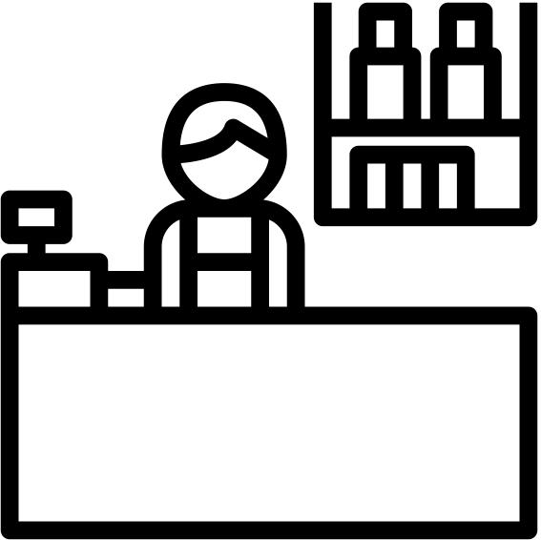
7 OUT OF 10 SATISFIED BY COMMUNICATION FROM USUAL RETAILERS
Have you been disappointed by a lack of communication from your usual retailers?
NO
DON’T KNOW
YES
?
71% aff 103
21% aff 134
24% aff 154
+ 50 y.o.
Dutch-speaking
French-speaking
71% aff 103
19% aff 116
18% aff 116
35-49 y.o.
18-34 y.o.
18-34 y.o.
BOOMERS & SENIORS MOST SATIFIED
Nearly 7 out of 10 people aged 50+ y.o. were happy with the communication of their usual retailers. 16% were undecided and only 13% were disappointed by their usual retailers.
Special shopping times, information about social distancing in the stores and other Covid19-related information were clearly appreciated by older age groups. At the contrary, nearly 1 out of 15 young adult in Belgium was not happy with retailers’communication efforts

Slide 18











COLRUYT, DELHAIZE AND ALDI WERE THE MOST VISITED FOOD SUPPLIERS
TOP 3 NL (ranked on selectivity)
TOP 3 FR (ranked on selectivity)
19%
aff. 162
48%
aff. 115
50%
aff. 103
8%
aff. 220
3%
aff. 141
21%
aff. 113
TOP 3 (ranked on selectivity)
TOP 3 (ranked on selectivity)
15%
aff. 129
3%
aff. 120
31%
aff. 110
4%
aff. 125
51%
aff. 106
44%
aff. 102
YOUNGER ADULTS PREFER IT LOCAL AND ORGANIC
18-34 y.o. have more often mentioned organic or local shops and retail brands. Drive services from supermarkets and food retailers are not yet a thing. But younger adults are twice more numerous to be into it
local or organic producer/shop
TOTAL BE
2%
14%
2%
drive services
18-34 y.o.
4%
17%
4%
Which supermarket chain or food supplier did you visit during the confinement period?

Slide 19
COLRUYT, DELHAIZE AND ALDI WERE THE MOST USEFUL FOOD SUPPLIERS
TOP 3 NL (ranked on selectivity)
TOP 3 FR (ranked on selectivity)
13%
aff. 153
35%
aff. 122
42%
aff. 106
7%
aff. 237
4%
aff. 164
31%
aff. 108
TOP 3 (ranked on selectivity)
TOP 3 (ranked on selectivity)
4%
aff. 152
18%
aff. 110
9%
aff. 110
4%
aff. 145
35%
aff. 120
46%
aff. 115
LOCAL & ORGANIC MUST PROVE UTILITY
Everyone agrees: local & organic producers have to reinforce their (brand) presence in the minds of consumers to appeal to more visitors and prove their utility (and distinction with supermarket retailers)
local or organic producer/shop
TOTAL BE
3%
16%
4%
drive services
18-34 y.o.
5%
16%
5%
Which supermarket chain or food supplier did you find the most useful during the crisis?

Slide 20
COLRUYT, LIDL & CARREFOUR BEST IN MEETING EXPECTATIONS
Did these retailer brands meet your expectations?
BEST IN CLASS
1
2
3
local or organic producer/shop
drive services

Slide 21

SOME FIRST CONCLUSIONS (and more to come)
CREATURES OF HABITS
Spring cleaning, cooking, watching TV together with other household members, preparing the garden for a new season… There is something reassuring about cultivating habits. Especially when times are uncertain
1
CREATURES OF HABITS… BUT OPEN FOR NEW ADVENTURES
Some favor physical shops, missing the human contact with local merchants (42%), other chose for online food retail services… The fact is: more Belgians than ever have find their way to e-food retailer. Other sectors, not as usual like gardening, also benefits from the lockdown online
2
MEDIA ARE A BASIC NEED
Just like eating or sleeping, media are part of our daily routine and rituals. More: they are a basic necessity fulfilling the need for information, reassurance, social exchange and entertainment
3

Slide 22

CULTURE & TECH

Slide 23

CONSUMPTION OF CULTURAL GOODS ROCKETED AMONGST YOUNG ADULTS
OTHER AGE GROUPS POSTPONED CULTURAL PURCHASES
1 OUT 4 YOUNG ADULTS BUY MORE CULTURAL PRODUCTS
14%
of respondents are buying more books and cultural products. Mostly adults younger than 35 y.o. (24%). Only 10% of Baby boomers (55+) invest more in culture
1
1 OUT OF 5 YOUNG ADULTS BUY MORE VOD & STREAMING
19%
of 18-34 y.o. Only 6% of respondents aged 35+ agree confinement have made the purchase of VOD films and streaming more favorable
2
FLEMISH POSTPONE CULTURAL PURCHASES
60%
of respondents planning to buy CULTURAL products have postponed their purchase till after the confinement. Flemish people (70%) are more numerous
2
1.-2.How does this COVID19 situation change your buying behavior? You do … 3. On a scale from 1 to 10, what purchases have you postponed pending the end of lockdown? (1-postponed nothing; 10-postponed every purchase scores 7-10 grouped)

Slide 24



LOCKDOWN FREEZES SPENDING IN CULTURE & TECH
Intentionalists are massively postponing their purchases
1 OUT 10 MISS CULTURAL PRODUCTS
BELGIANS ARE WELL EQUIPPED
10%
missed cultural products just after a few days of lockdown. Young adults (16%) more than active Baby boomers (7%). Women (12%) more than men (9%)
2%
missed technological products just after a few days of lockdown. Flemish people (3%) slightly more than French-speaking(2%), partially unemployed (3%) more than homeworkers (1)%.
60% HAD BUYING INTENTION BEFORE LOCKDOWN
54% HAD BUYING INTENTION BEFORE LOCKDOWN
60%
of these intentionalists postponed (nearly) every purchase regarding cultural goods or services. Homeworkers (63%) postponed more often than partially unemployed (49%)
47%
of these intentionalists postponed (nearly) every purchase regarding tech products. There are no noticeable differences between the different targets surveyed. Not surprising as tech products have high entry prices
After a few days of lockdown, do you miss the following products or services? On a scale from 1 to 10, what purchases have you postponed pending the end of lockdown? (1-postponed nothing; 10-postponed every purchase scores 7-10 grouped)

Slide 25
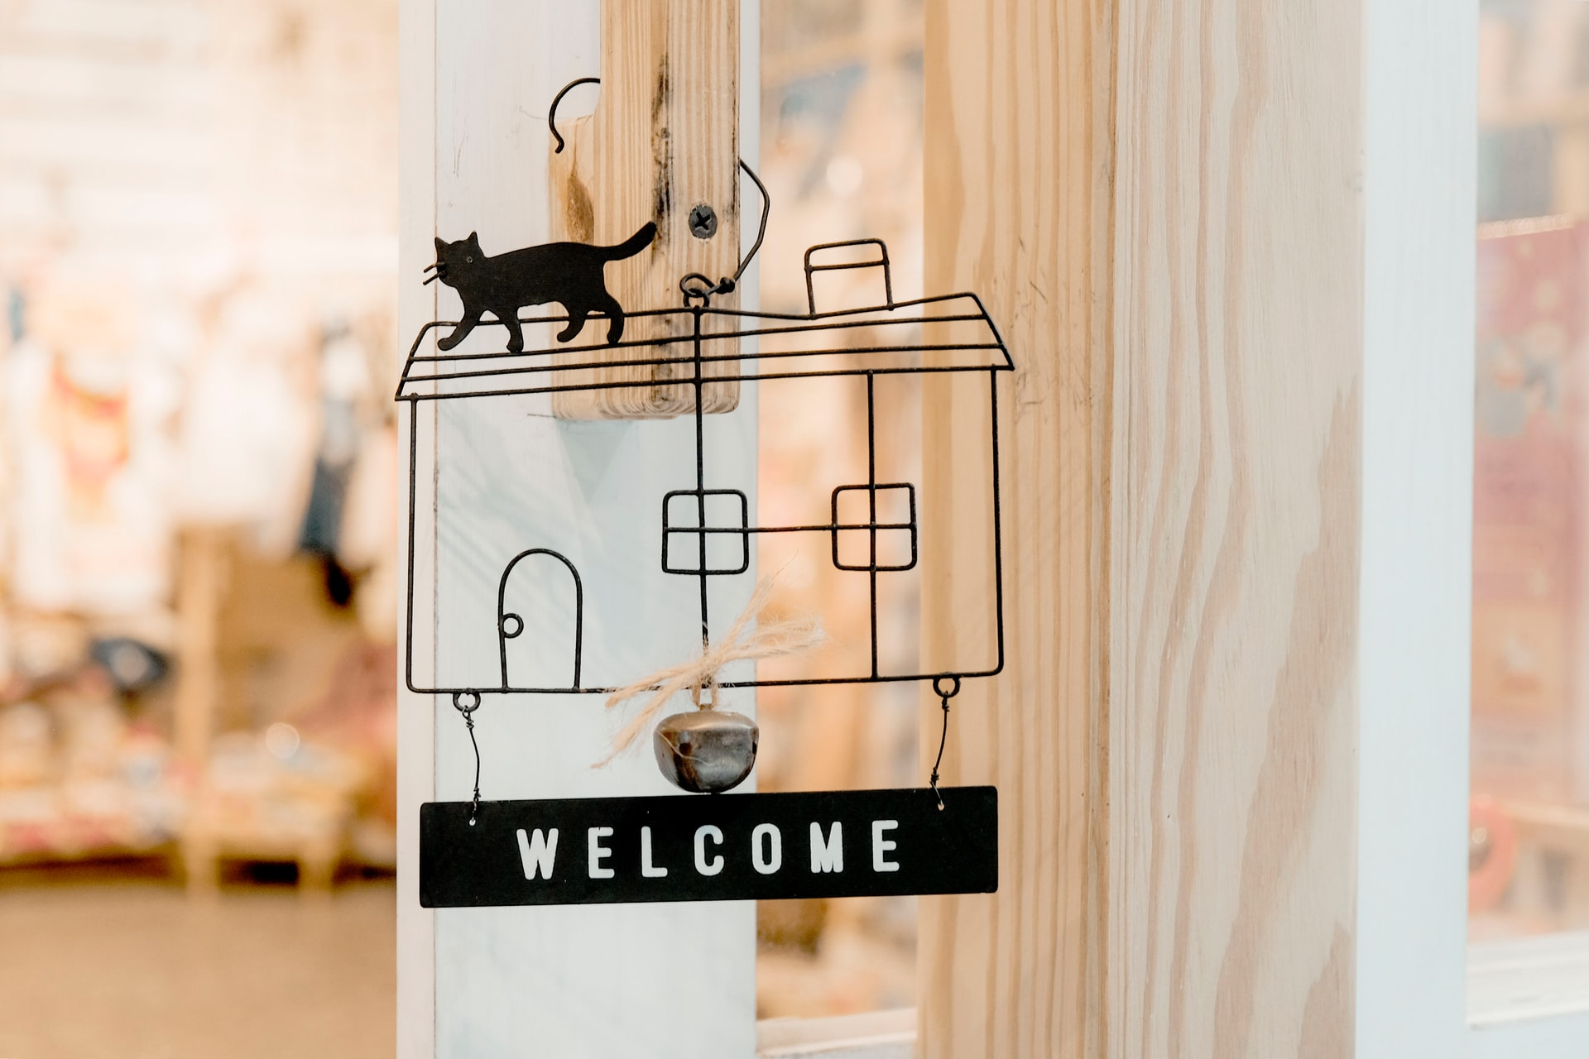


1 OUT OF 2 POSTPONES SPENDINGS TO « UPGRADE » HOME & COMFORT
Intentionalists are massively postponing their purchases
HAPPY IN THE CURRENT CONFIGURATION
BELGIANS ARE WELL EQUIPPED
6%
missed deco & furniture just after a few days of lockdown. Young adults between 18 and 24 years old (10%) more than other age groups
4%
missed household appliances products just after a few days of lockdown. People between 25 and 34 years old (8%) slightly more than other age groups
57% HAD BUYING INTENTION BEFORE LOCKDOWN
55% HAD BUYING INTENTION BEFORE LOCKDOWN
49%
of these intentionalists postponed (nearly) every purchase regarding decoration. Women (52%) postpone more often man ((47%)
47%
of these intentionalists postponed (nearly) every purchase regarding household appliances. Intentionalists within older age groups (50+) more often than younger ones
After a few days of lockdown, do you miss the following products or services? On a scale from 1 to 10, what purchases have you postponed pending the end of lockdown? (1-postponed nothing; 10-postponed every purchase scores 7-10 grouped)

Slide 26

BE ONLINE TO INSPIRE CUSTOMERS WHEN SITUATION WILL RECOVER
MORE ONLINE SHOPPING
41%
of respondents are purchasing more online since the lockdown. More than one out of two is aged 18-34 y.o. (55%)
1
YOUNG ADULTS SHIFT FROM PHYSICAL TO ONLINE
33%
of 18-34 y.o. do agree the lockdown has created favorable conditions to order online for products purchased in store so far (against 19% for 35+)
2
(nearly) 1 OUT OF 5 MEN VISITED A NEW E-TECH SITE
15% of respondents surveyed visited a new e-commerce site related to tech products during lockdown. 1 out of 4 respondents aged between 18 and 34 y.o.
How does this situation changed your buying behavior? You do/use more… (Yes) How does this COVID19 situation change your buying behavior? You do …

Slide 27












DIGITAL NATIVES TOOK ADVANTAGE OF SITUATION
STRONG REGIONAL DIFFERENCES REGARDING PURE PLAYERS
Which non-food retailer from the list did you find the most useful during the crisis?
TOP 5 (ranked on affinity)
9%
aff. 133
6%
aff. 123
6%
aff. 118
2%
aff. 112
8%
aff. 112
1%
aff. 119
11%
aff. 116
7%
aff. 108
17%
aff. 106
4%
aff. 104
18-34 y.o.
3%
aff. 265
13%
aff. 203
18%
aff. 194
12%
aff. 166
11%
aff. 166
35-49 y.o.
5%
aff. 143
2%
aff. 129
9%
aff. 118
19%
aff. 113
5%
aff. 113
+ 50 y.o.
5%
aff. 119
5%
aff. 104
3%
aff. 84
6%
aff. 76
12%
aff. 72

Slide 28
RETAILERS WILL FACE TOUGH TIMES BUT HAVE TO BE PREPARED
BASIC NEEDS DURING CONFINEMENT?
Besides food & essential products, think media, cultural products & services in a “home sweet home” configuration
MOST USEFUL NON-FOOD RETAILERS:
WELL-EQUIPPED
Most Belgians are well-equipped regarding tech products. Intentionalists postponed their purchases massively but few are really missing new tech products
1
NEARLY 6 OUT OF 10 WANTED TO REVAMP THEIR DECO
2
And again, spendings in decoration will have to wait till after the lockdown and the evolution of the financial solution for 1 out of 2 intentionalists
3
1 OUT 2 WANTED TO BUY HOUSEHOLD APPLIANCES
But 1 out of 2 intentionalists have seen this resolution melting during the lockdown

Slide 29
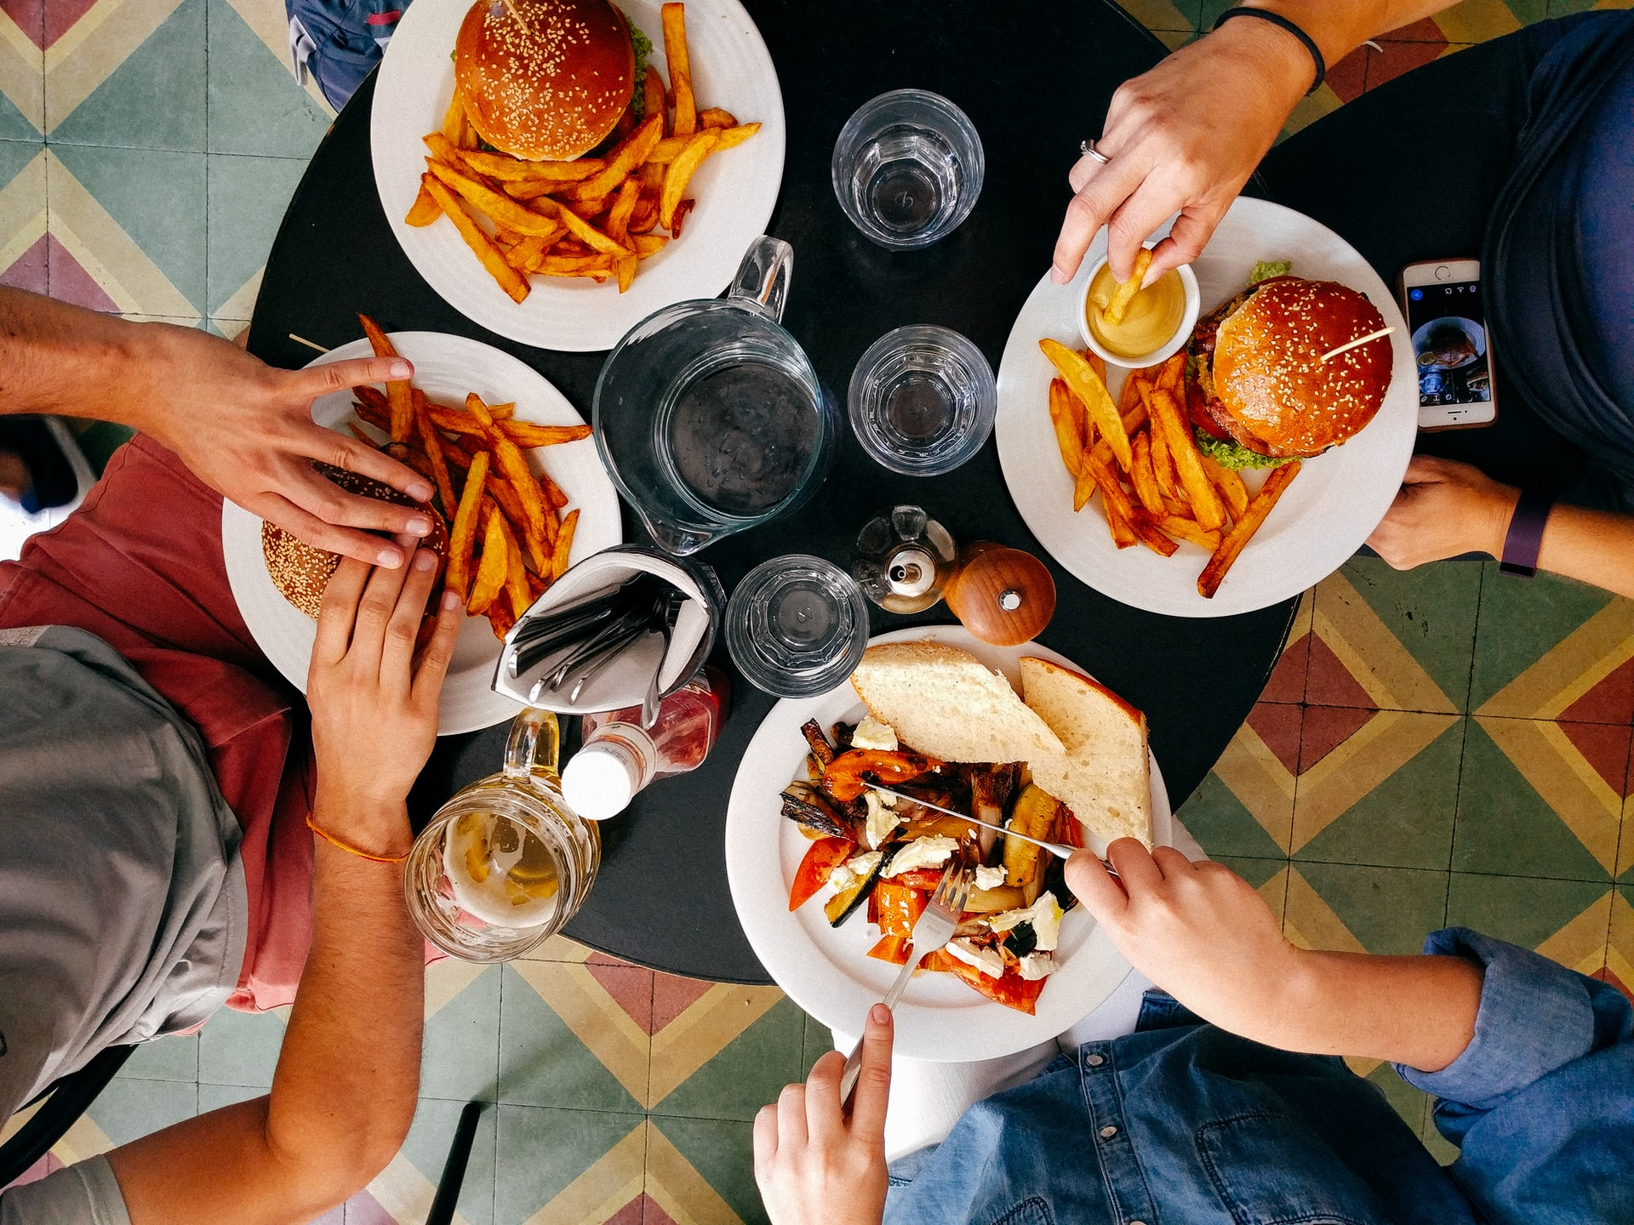


POST-LOCKDOWN ASPIRATIONS: NORMALITY, FRAMILY AND A GOOD MEAL
What will you do once the lockdown is over?
67%
44%
return to a normal life
go to the restaurant
63%
meet my relatives

Slide 30
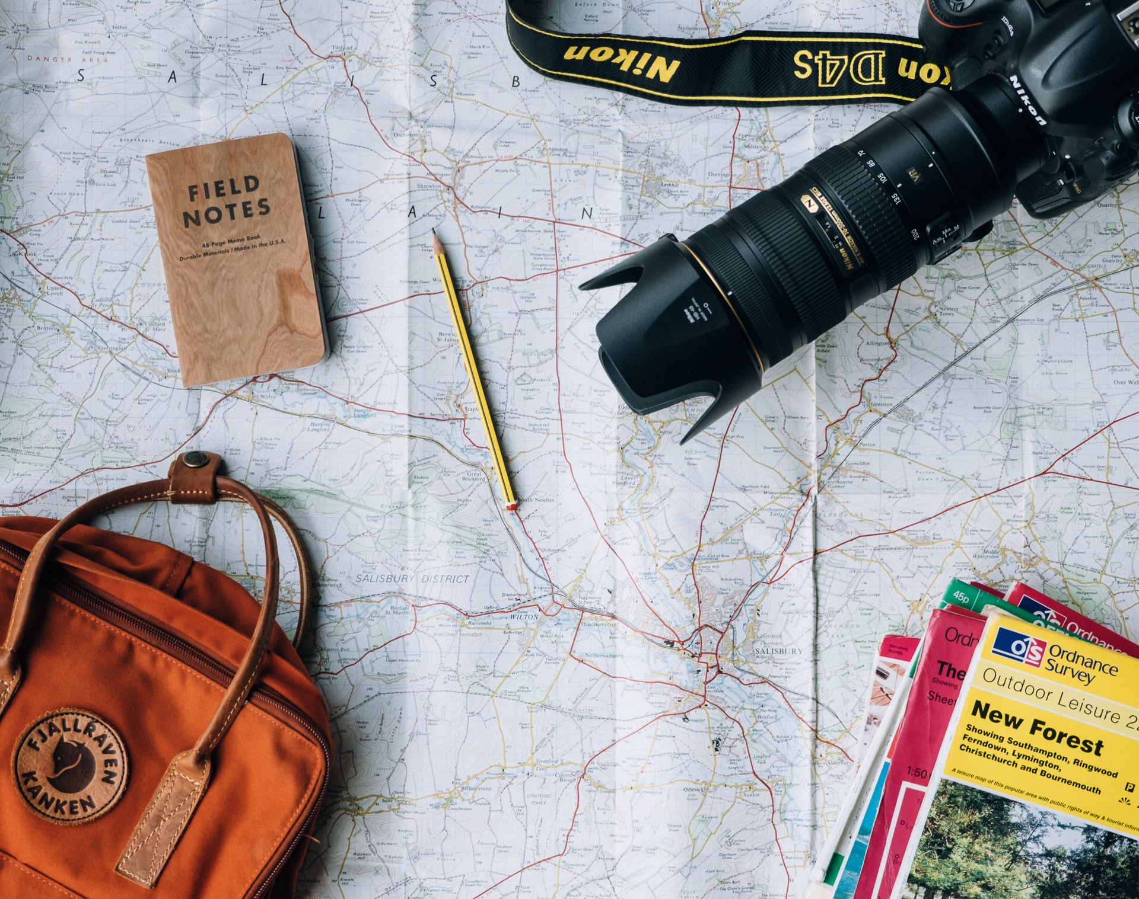
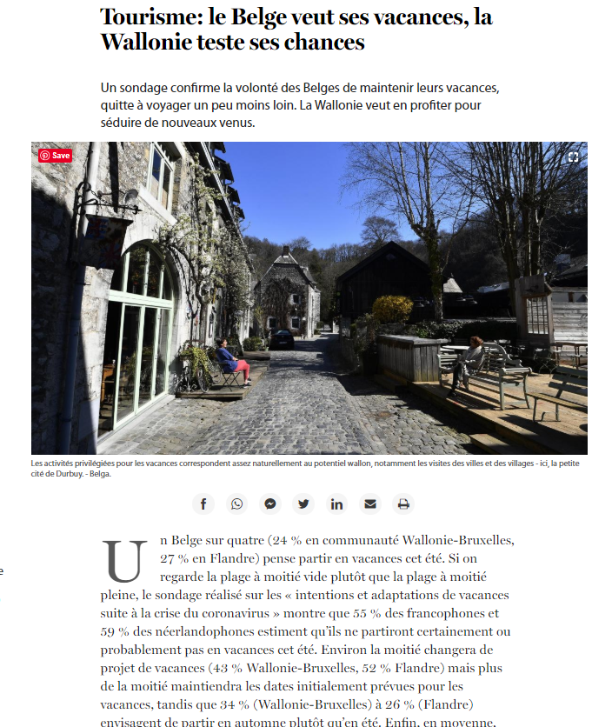

LAST TIP FOR TRAVEL SECTOR: MONITOR ONLINE INTENTION & HUNGER FOR ESCAPE
55% POSTPONE TRAVEL PLANS
8 out of 10 travel intentionalists have postponed their plans to purchase transport & travel accommodations. But nearly
1 out of 10 (9%) has discovered a new travel site during the lockdown
BOOMERS MORE LIKELY TO POSTPONE TRAVEL PLANS
68% of people aged 65+ had plans to purchase transport/travel accommodations before the lockdown. 85% postponed their plans till the situation recovered. Younger Boomers (50-64 y.o.) seem even more worried: 87% postponed
YOUNG ADULTS ARE READY TO BOOK
75% of 18-34 y.o. had plans buying transport or travel accommodation before the lockdown. 78% have already postponed these plans. Nearly 1 out of 5 (18%) has discovered a new travel site during the lockdown
Belgians want their holidays
1 OUT OF 4 BELGIAN IS THINKING OF GOING ON VACATHION THIS SUMMER
(Le Soir 05/05/2020)
After a few days of lockdown, do you miss the following products or services? On a scale from 1 to 10, what purchases have you postponed pending the end of lockdown? (1-postponed nothing; 10-postponed every purchase scores 7-10 grouped)

Slide 31
CONTACT
vanessa.sanctorum@havasmg.com
Brussels

